Slide 1
Joining the dots – towards a holistic approach to mental health in construction.
Jim Beestone, Balfour Beatty/HCLG
9/7/24
Notes:
This presentation was automatically generated by PowerPoint Copilot based on content found in this document: https://balfourbeatty-my.sharepoint.com/personal/james_beestone_balfourbeatty_com/_layouts/15/Doc.aspx?sourcedoc=%7BABD7700D-2024-44BF-847B-748E071983D9%7D&file=Mental%20Health%20Framework%20for%20Construction.docx&action=default&mobileredirect=true&DefaultItemOpen=1 AI-generated content may be incorrect.

Slide 2
What crisis?
Construction faces a mental health epidemic, best evidenced in its suicide statistics.
A widespread belief is that if we tackle mental ill health, we tackle suicide.
Is our approach working?
Is it time to re-evaluate?
“Suicide among people without diagnoses might be more likely to have been precipitated by acute stressors, rather than enduring mental health issues, providing little opportunity for intervention.”
Frontiers in Public Health 2020

Slide 3
Risk factors
Demographics
‘Macho’ culture
Peripatetic workforce
Programme stress
Workload/working hours
Harsh physical environment
Poor mental health literacy
At-risk employment
Relationship issues caused by working arrangements
Financial distress caused by late payment
Supply chain contraction/organisations collapsing
Traumatic incidents/trauma responses.
Inequalities in provision between employed/subcontracted.
Isolation
Notes:
This slide discusses the challenges and opportunities of project-based work, including the impact of uncertainty and the need to mitigate peak periods for workers. It also covers the changing workforce and demographics, as well as the differing requirements for workers based on their location. Original Content: o Project based working is about change – positive and challenge to include impact of uncertainty and how to mitigate peak periods for workers when they may experience threat-based responses. o Opportunities and challenges of working patterns and that whilst individuals may prefer shift work, for example, there is a responsibility to support risk mitigation for negative impact as well as flexibility gains. o Changing workforce and demographics – increasing gender diversity and recognising increasing neuro diversity, ageing profile – chronic health conditions and digital exclusion o Differing requirements for those working onsite versus office based versus home based and travelling

Slide 4
A crisis of crises
Construction has, over the last decade, undergone a culture shift in terms of mental health.
However, an unspoken assumption has been that by tackling mental ill health, we tackle suicide
The statistics are not bearing that out
Can we look to a model that ‘joins the dots’ between different forms of mental health provision, endemic risks in the industry, and suicide prevention?
“People who die by suicide without receiving mental health services are likely to have diverse profiles, indicating the need for multifaceted approaches to effectively support people at risk of suicide.”

Slide 5
Joining the dots: the missing link
Cross-industry work on mental health
Combination of contractors, third-sector groups, industry bodies and regulator
Role of clients is less clearly defined and understood

Slide 6
Broadening our approach
Changing stances on mental health in the industry has been a focus historically
Less focus has been placed on the environmental/endemic factors
How do we tackle the risk factors for suicide which can seem ‘baked-in’ to how we do business?
How do we ensure that all parties, from tender through to asset management and demobilisation, play their role?
‘Getting Left’ on mental health and suicide prevention
“We found some evidence to suggest that those experiencing acute stressors, such as financial difficulties, prior to suicide were less likely to have received [mental health support] services”

Slide 7
Joining the dots: aligning mental health support and substantive change
Aligning key stakeholders from across the industry, to create a sector that tackles mental health holistically, in a physical, social and contractual environment which sets its workforce up for success
Mental health does not start and end with the individual
A balance of proactive and reactive mental health support
Combating a ‘culture of precarity’ and material threats to individuals is key
Challenge custom and practice

Slide 8
7 dimensions of support
Physical
Financial
Relationships
Emotions
Culture & Belonging
Work design
Crisis Response
Notes:
Agenda * Introduction * Dimension 1: Physical Safety * Dimension 2: Financial Safety * Dimension 3: Relationship Safety * Dimension 4: Emotional Safety * Dimension 5: Belonging and Sense of Purpose * Dimension 6: Work Design and Culture * Dimension 7: Crisis Response

Slide 9
Physical Safety
Research-led: University of Warwick 2023
Welfare – above & beyond CDM
Health support - site-based screening and direct support/ signposting
Workforce consultation
Notes:
This slide covers the various measures taken to ensure the well-being of workers, including physical safety, access to basic needs, health support, and language support. A case study of Jim is also included. Original Content: o Physical safety o Access to food, water, temperature-controlled areas, quiet, sleep, health conditions and substance misuse o Site based screening and direct support – running clinics on fit for role medicals and invite in screening with low uptake i.e. prostrate/heart/diabetes o Scale and sign-post to local services o Workers with English as a second language/non-English speaking – can be the Supervisor is bi-lingual and is trained in and required to provide information on access to key services/training o Jim’s case study

Slide 10
Financial Safety
Macro/micro
Timely payments
Support for next contract
Financial literacy development
Advice and support
Notes:
This slide covers the topics of financial safety and literacy. We ensure timely payments and support for your next contract. We also provide advice and support for financial literacy development, including a case study for practical application. Original Content: o Financial safety o Payment on time, next contract, supporting through project end into next contract o Financial literacy development and advice/support (Case study)

Slide 11
Relationship Safety
Supporting personal and professional relationships inside and outside work
Supporting different cultures/ethnicities/language requirements
Include family in events and invite them to the site
Learning from other sectors
Notes:
In this project, we aim to support key relationships by ensuring relationship safety, providing access to Wi-Fi and quiet space to connect with home, providing cultural support, and including family in events. We can also look to other sectors, such as the army, for ways to connect partners. Original Content: o Relationship safety o Things to support key relationships through project (local working, access to wi-fi and quiet space to connect with home regularly, cultural support through conversations and valuing of relationships, include family in events/invite to site) o Look to other sectors potentially for learning i.e. army connecting partners

Slide 12
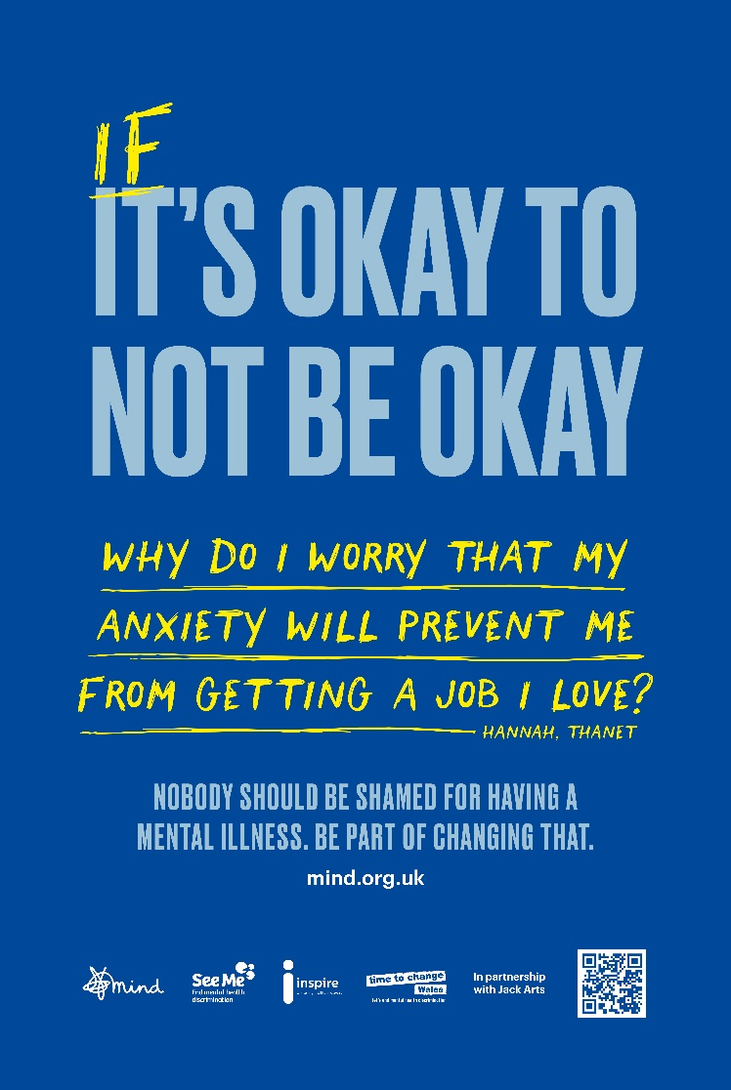
Emotional Safety
Creating a safe and inclusive environment
Mental health literacy
Training on work/role-specific mental health awareness
Identifying and addressing mental health concerns
Notes:
This slide discusses the importance of emotional safety and mental health literacy. It covers training on mental health awareness, respect and inclusion, and a case study on the limitations of a single multi-use room. These are all important factors in creating a safe and inclusive environment. Original Content: o Emotional safety o Mental health literacy - training on mental health awareness and being able to identify and o Behaviours and skills – respect and inclusion o Case study – not having one multi-use room and saying it meets all needs

Slide 13
Culture & Belonging
Includes sense of purpose – identified as a key marker for reducing workplace stress
Induction and leadership behaviours – ‘setting the tone’
Mentoring/buddying
Apprentices/Early careers
Neurodiversity/demographics
Notes:
In this slide, we will discuss the importance of belonging and leadership in the workplace. We will explore how creating a sense of purpose, effective induction, positive leadership behaviours, and implementing mentoring, buddying, and small group programs can increase employee satisfaction and productivity. We will also look at NASA as an example of an organization that has successfully implemented these practices. Original Content: o Belonging and sense of purpose o Induction and leadership behaviours o Mentoring/Buddying/Creating small groups (especially Apprentices but think about all those working onsite) o NASA example

Slide 14
Work Design
Transparency and accountability
Forum for feedback
Clarity on programme
Mental health assessed as a risk and proactively controlled
Notes:
This slide discusses work design and culture, including transparency and accountability, and a forum for feedback. Support is extended through the supply chain and is site-based. There are also sport and team opportunities, such as construction sport, green man walking, and darts. Original Content: o Work design and culture o Transparency and accountability o Forum for feedback o Support extended through supply chain so that it is site based rather than organisation based o Sport/Team opportunities – Construction Sport o Walking – Green Man Walking o Darts ??

Slide 15
Crisis Response
Peer support/MHFA
Employee Assistance Programme
Signposting services
Support extended through supply chain
Site-based rather than organization-based
Notes:
In this presentation, we will be discussing crisis response and direct support on mental health. These are important topics that require our attention and action. Original Content: o Crisis response o Direct support on mental health

Slide 16
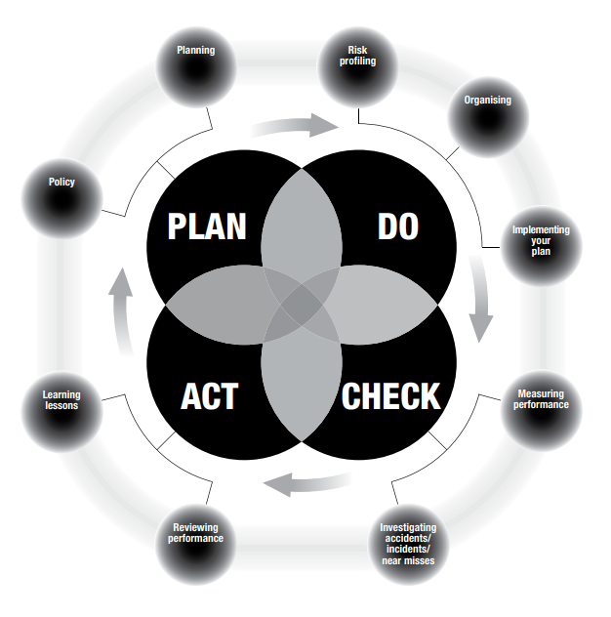
What comes next?
Finalise framework through collaboration with Tier 1 contractors, HCLG, industry and trade bodies
Collaborate with industry – ‘what does good look like’?
Publish as a guidance note for clients and contractors alongside procurement framework
Continue to monitor, review and publish best practice

