Slide 1
Health and wellbeing in the workplace
Rachel Suff, Senior Employment Relations Adviser

Slide 2
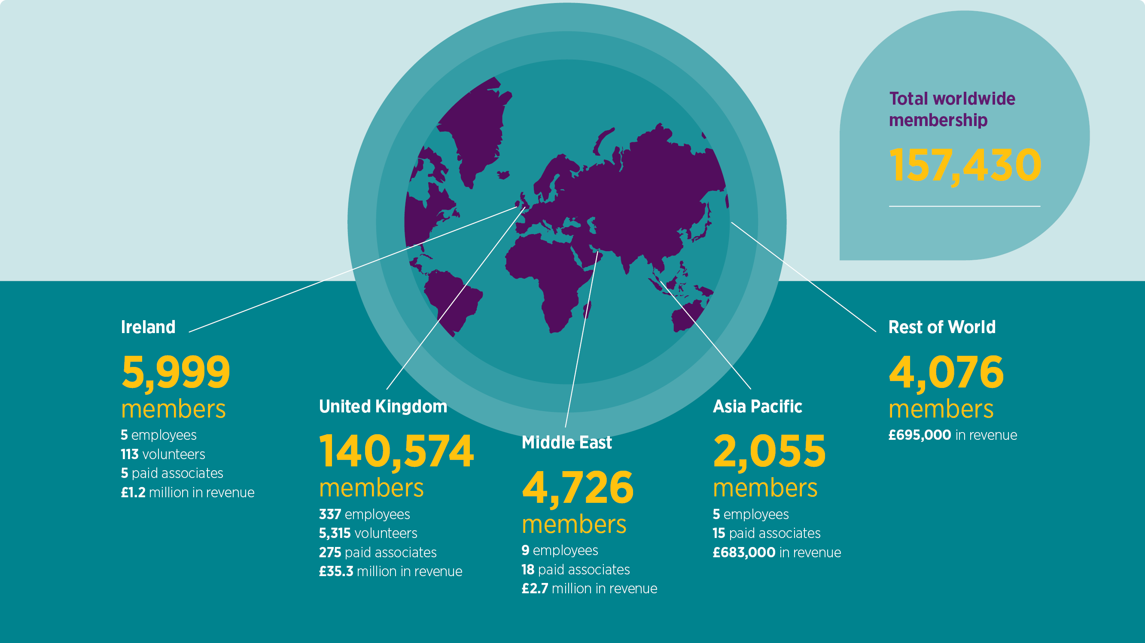
A worldwide community of people professionals
Notes:
We’ve seen eight consecutive years of growth in CIPD membership, and our 2019-20 financial year saw membership grow 2% overall.
This is a sign of continued interest in professional development and accreditation amongst those working in HR, L&D, OD&D and other related disciplines and specialisms.
We have offices in the UK, Ireland, Middle East and Asia. Our biggest growth last year was in the Middle East, where membership grew by 13.5% to 4,726 members.
We work hard to ensure our members feel part of a community where they can be guided, supported and inspired by other professionals, as well as opportunities to give back to their profession and we’re lucky to have a network of more than 5,000 volunteers to help us do that through peer-to-peer mentoring, local learning and networking events and social impact programmes that champion better work and working lives in the wider community.

Slide 3
The CIPD
Offices in the UK, Ireland, Middle East and Asia
A partner and a voice for people professionals
157,430 members worldwide and 5,000+ volunteers and associates
All committed to championing better work and working lives

Slide 4
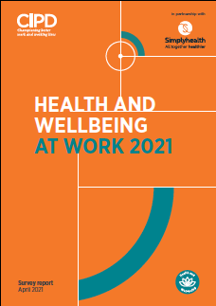
Welcome and today’s session
Are we fostering healthy workplaces for health and wellbeing, supported by good people management practices?
What impact has the pandemic had on people’s health and wellbeing, and employer practices?
What are the main challenges for people’s wellbeing and what action is needed?
What role do line managers play in supporting good wellbeing, and how are they supported?
www.cipd.co.uk/healthandwellbeing

Slide 5
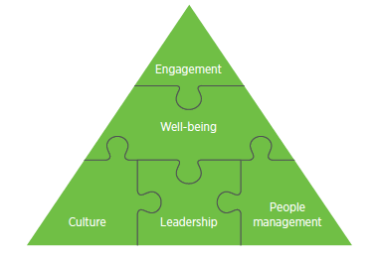
Most employers take a holistic approach to wellbeing
Employers’ focus on the key domains
of wellbeing:
Good mental health – 90%
Good work – 74%
Collective/social relationships – 73%
Values/principles – 73%
Good physical health – 72%
Personal growth – 61%
Good lifestyle choices – 57%
Financial wellbeing – 41%

Slide 6
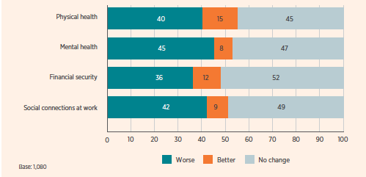
COVID-19 and mental health
Over two-fifths (42%) of HR professionals are ‘extremely concerned’ about the impact of the pandemic on people’s mental health and a further two-fifths (40%) are ‘moderately concerned’…
Employees: As a result of the COVID-19 lockdown, are the following better or worse off?

Slide 7
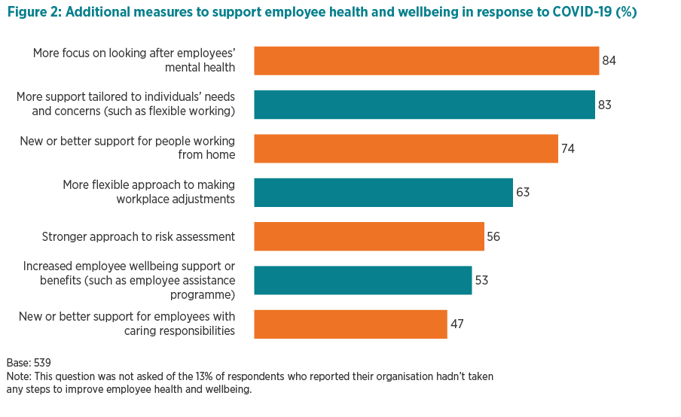
COVID-19: Supporting people’s health & wellbeing

Slide 8
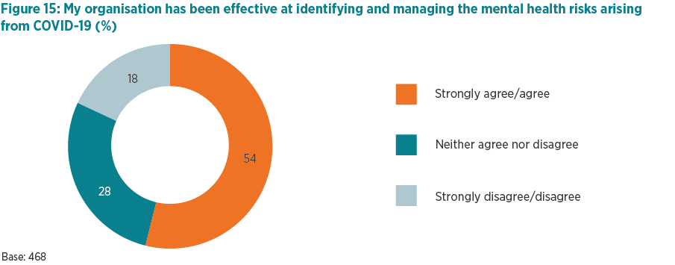
Managing the mental health risks arising
from COVID-19

Slide 9
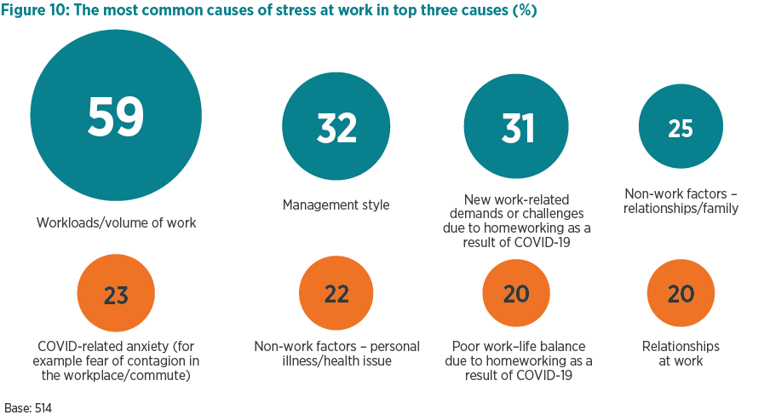
What are the top causes of stress at work?

Slide 10
Good people management is key to effective wellbeing support – but much more investment
is needed
Notes:
RACHEL:
And we know from our research over years with Simplyhealth that even before the pandemic, the increasing expectation on LMs to support ppl’s HWB was not matched by the level of investment most receive in terms of training, ongoing guidance, support …And their need for that support is even greater now, especially given that they too are likely to be experiencing many of the same challenges as the people in their teams, and also they will be dealing with all of the operational demands on them as the business continues to respond to COVID-19,
Already know from CIPD research that line managers are the ‘squeezed middle’ very often, and face competing demands, under pressure to on technical/operational priorities but also deliver on their people management role

Slide 11
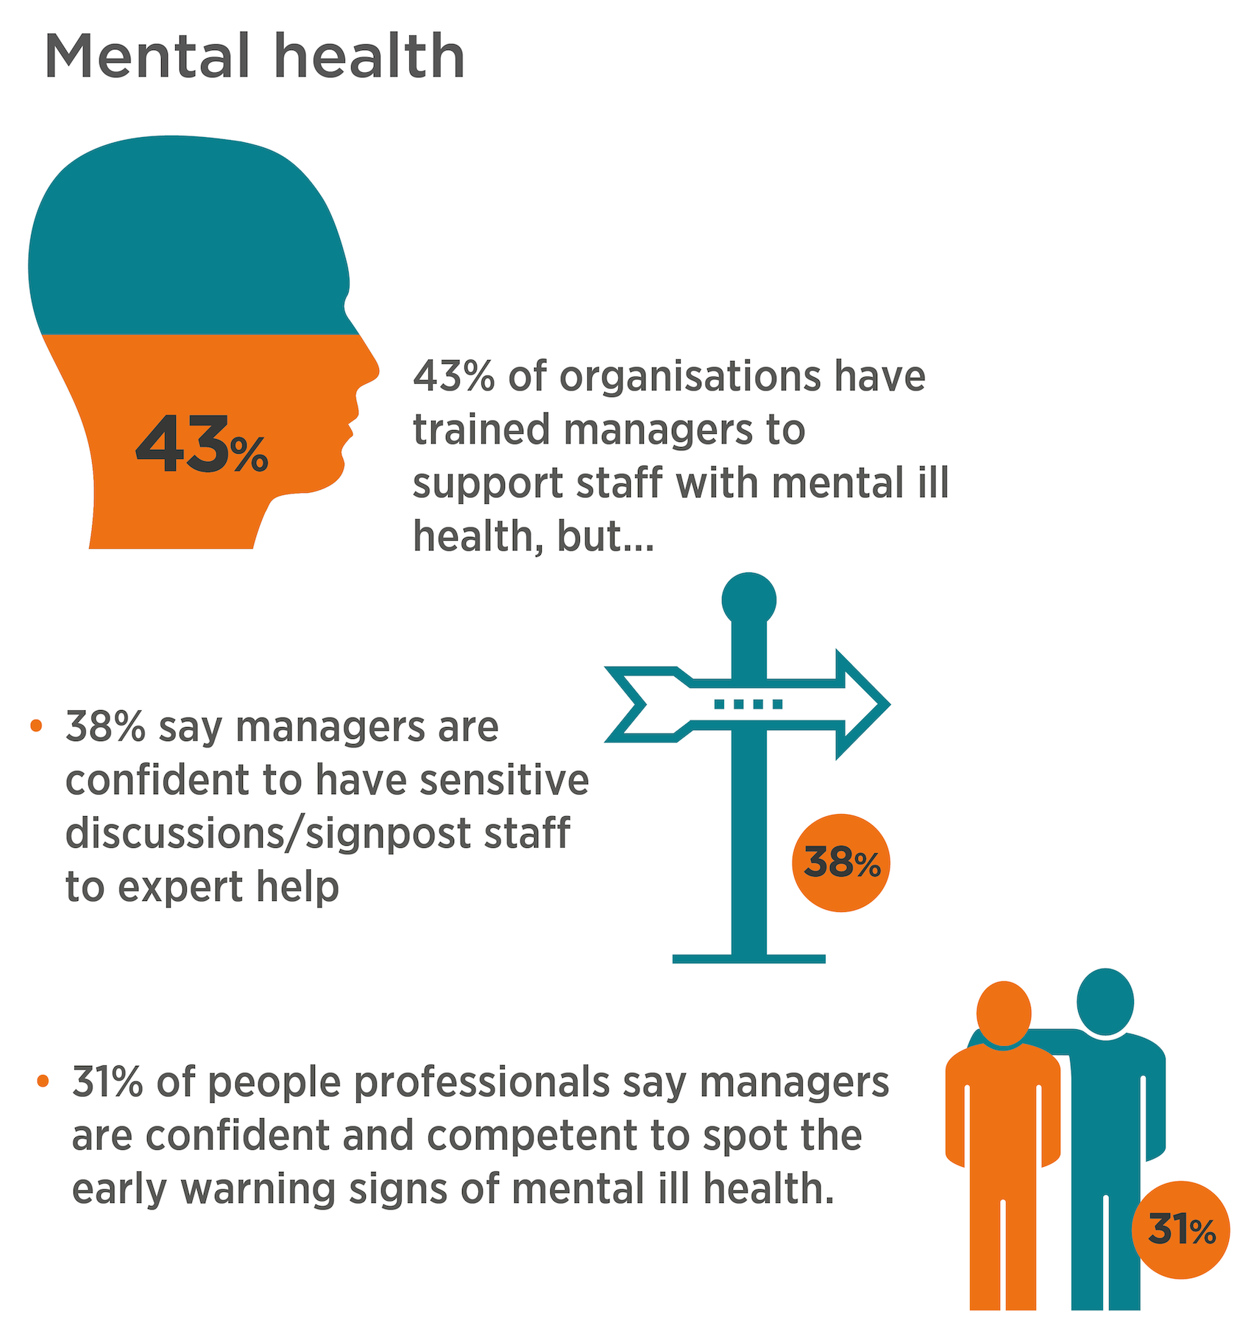
CIPD/Simplyhealth Health and Wellbeing at Work survey report 2021
Since the onset of COVID-19 has your employer/line manager checked on your health and wellbeing?
Notes:
RACHEL:
On LHS - Infographic is from our annual HWB survey with SH
Well under ½ [43%] of orgs have trained managers to support ppl with Mental ill hlth [actually decreased from last year, was 51%]
…so not surprising – as can see on this slide - that there are also low levels of confidence on the part of HR professionals for line management capability in this area in this area…
38% think managers can have sensitive discussions and signpost to expert help
31% of managers can spot the early warning signs of mental ill health
Chart on RHS – since the pandemic we have also been regularly surveying employees on their experience of work – and we asked:
Since the onset of COVID-19 has your employer/manager checked on your HWB?
Most recent data from September shows – 1/3 haven’t!
Disappointing – many organisations have been changing their management practices to ensure that HWB is embedded in all 121 catch ups, is the first part of the conversation – so that discussion isn’t just work-focused but starts with how the person is – won’t necessarily happen automatically, line managers are guided and trained to have those conversations and there has to be a trusting relationship for that to happen
. Couldn’t be more important at the current time…

Slide 12
The pandemic has made employee health and wellbeing a priority in the boardroom…
…let’s keep it that way!

Slide 13
Thank you
Questions?
www.cipd.co.uk/healthandwellbeing

